Slide 1


Azim Premji Foundation
…towards a just, equitable, humane and sustainable society

Slide 2

Integrated work
The Foundation operates as an integrated unit with its three operating arms complementing each other.
Field Institutes – the on-ground, district and block level presence
Philanthropy – supports NGO/CSO partners with financial grants
University – for higher education, in Bengaluru and Bhopal.
These entities work together to integrate grassroots and systemic knowledge to contribute to policy, research, and continuing education.
Our Focus Areas
Education, Health and Livelihoods

Slide 3
About Azim Premji Foundation
Azim Premji Foundation was set up by Azim Premji in 2001 with a clear social purpose of making a significant, long-term contribution to the nation’s development. Over the past years, Azim Premji has irrevocably donated most of his wealth for philanthropic purposes and created a philanthropic endowment valued (as of Jan 2023) at approximately INR 2,40,000 crore (USD 29 billion) to fund the work of the Foundation. As part of this endowment, along with other assets, 66 percent of the economic ownership of Wipro Ltd is with the Foundation.
Address
Azim Premji Foundation,
#134 Doddakannelli,
Next to Wipro Corporate Office,
Sarjapur Road,
Bengaluru - 560035
Tel: +91-80- 6614 4900/01/02

Slide 4
About Azim Premji University
Azim Premji University was established under the Azim Premji University Act 2010 of the Government of Karnataka. Azim Premji Foundation, the sponsoring body set up the University as a fully philanthropic and not-for-profit entity, with a clear social purpose of contributing to the realisation of a just, equitable, humane and sustainable society.
All our educational programmes consciously nurture and reflect this vision of the University.
Azim Premji University, Bhopal is operational (from the academic year 2023 – 24). It is established under the provisions of Madhya Pradesh Niji Vishwa Vidyalaya (Sthapana Avam Sanchalan) Dwitiya Sanshodhan Adhiniyam, 2022.
Address
Azim Premji University, Bengaluru
Survey No 66, Burugunte Village,
Bikkanahalli Main Road,
Sarjapura, Bengaluru 562125
Azim Premji University, Bhopal
Kanhasaiya, Bhopal Vidisha Bypass Road,
Bhopal-462022
More details: https://azimpremjiuniversity.edu.in/contact-us

Slide 5
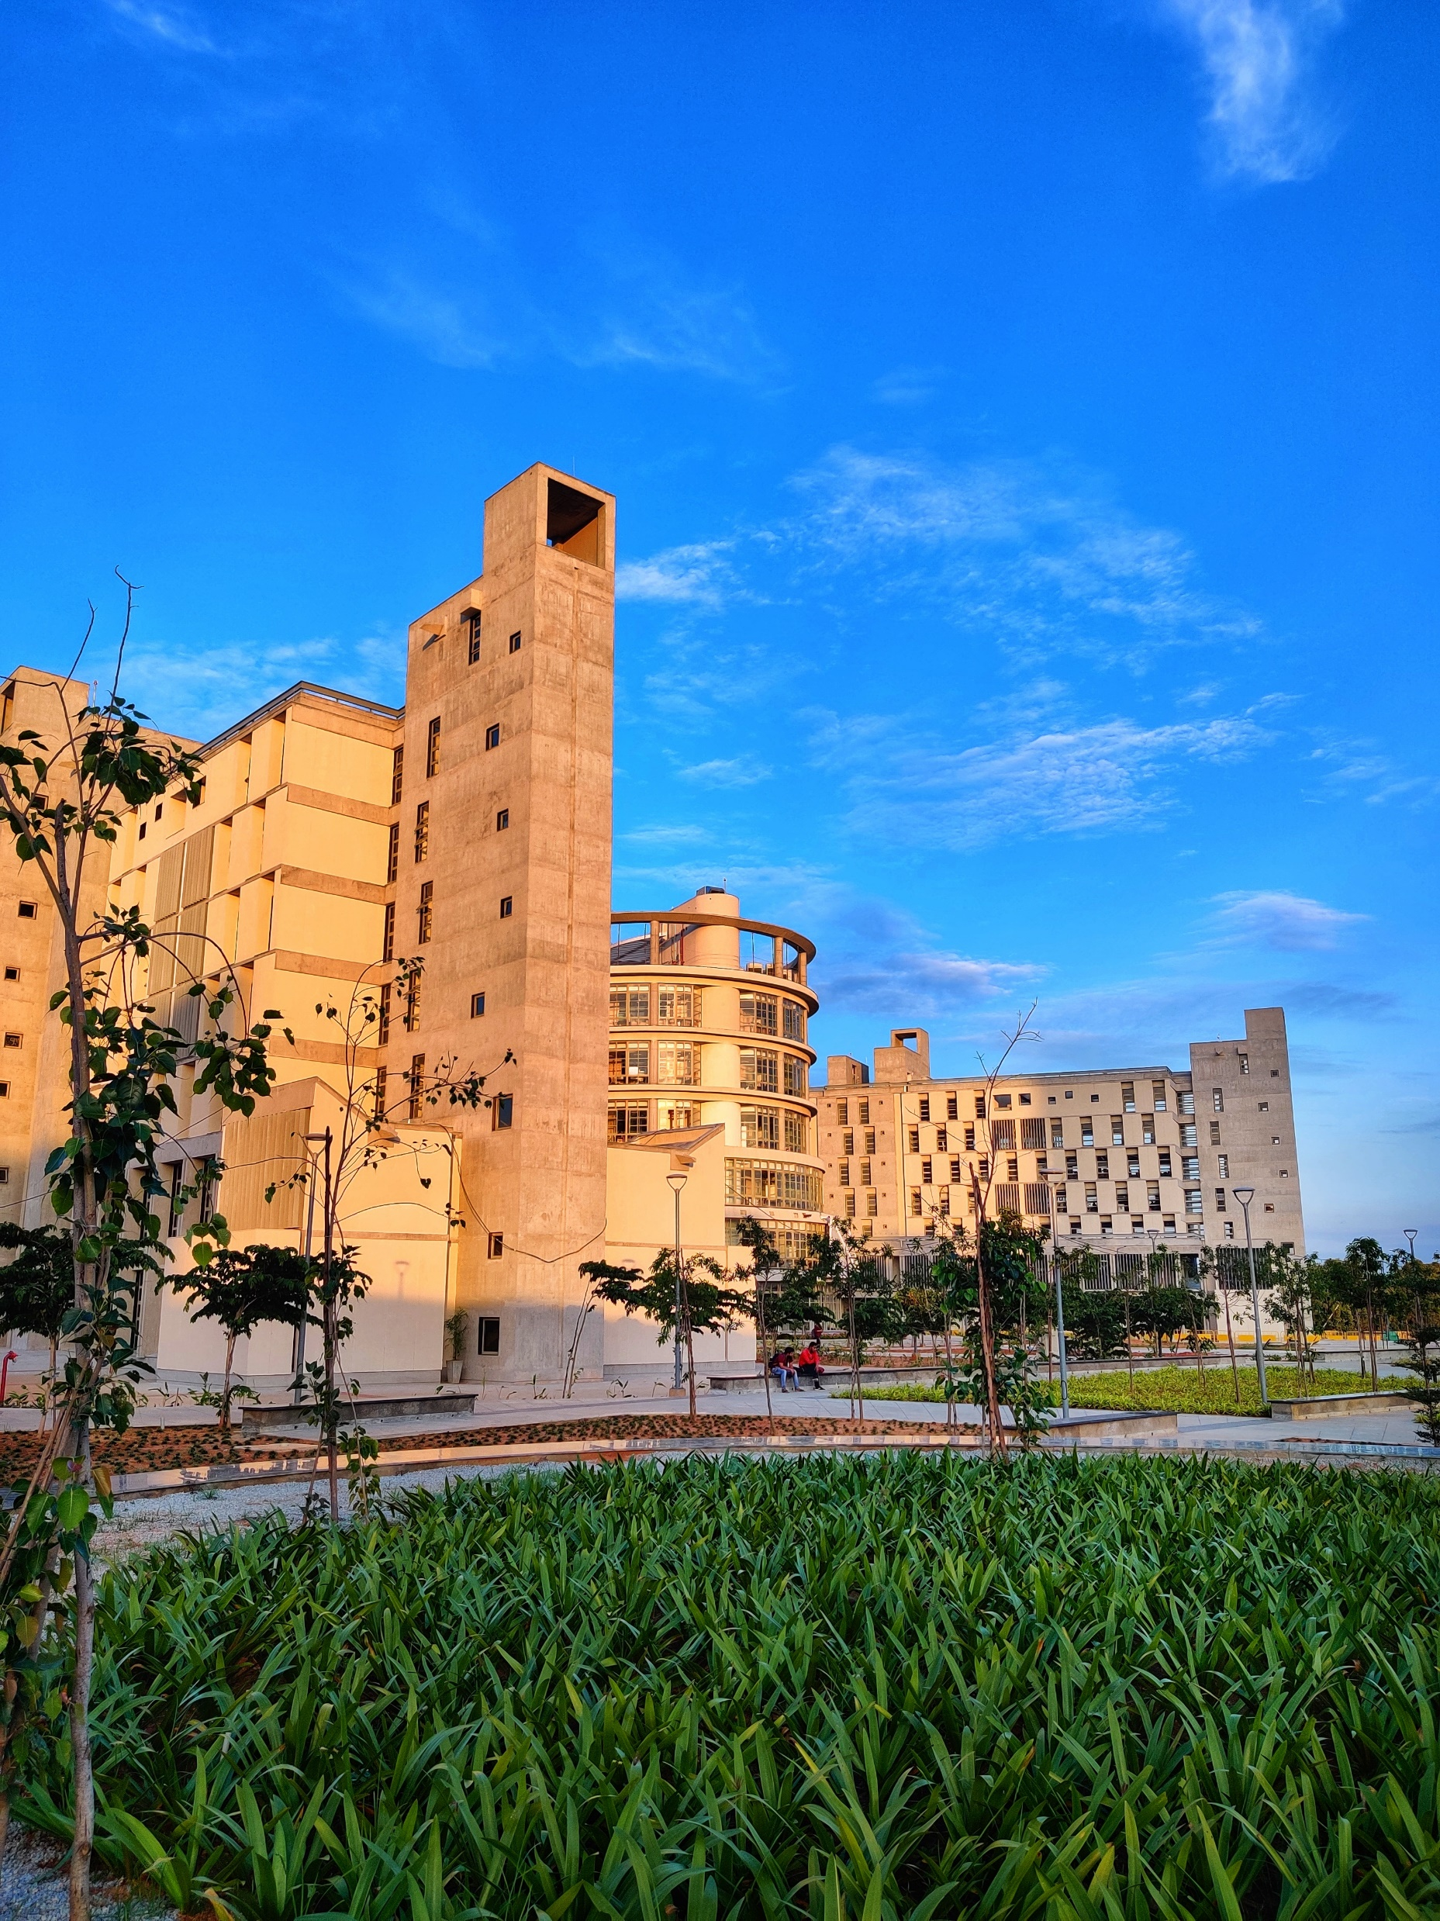
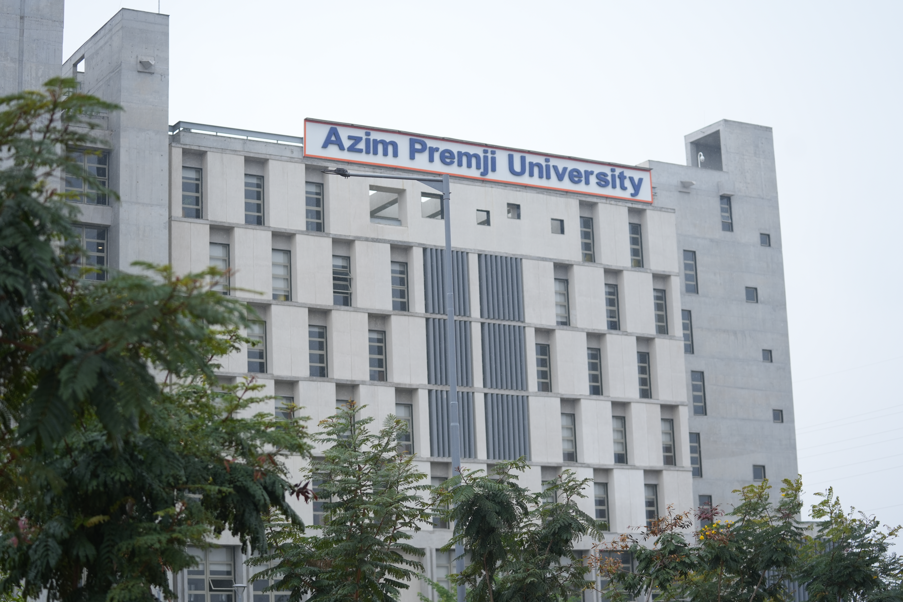
Azim Premji University, Bengaluru

Slide 6
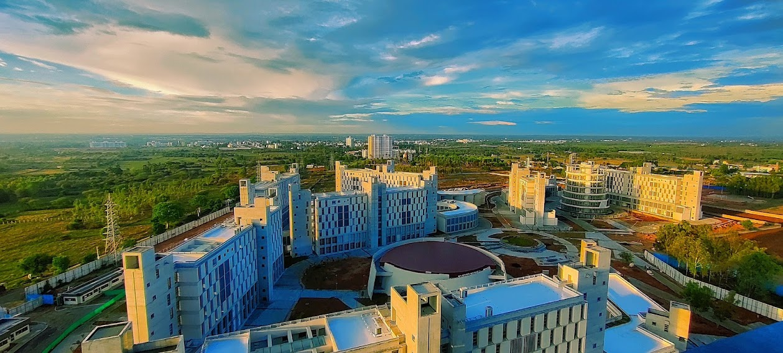
Azim Premji University, Bengaluru

Slide 7
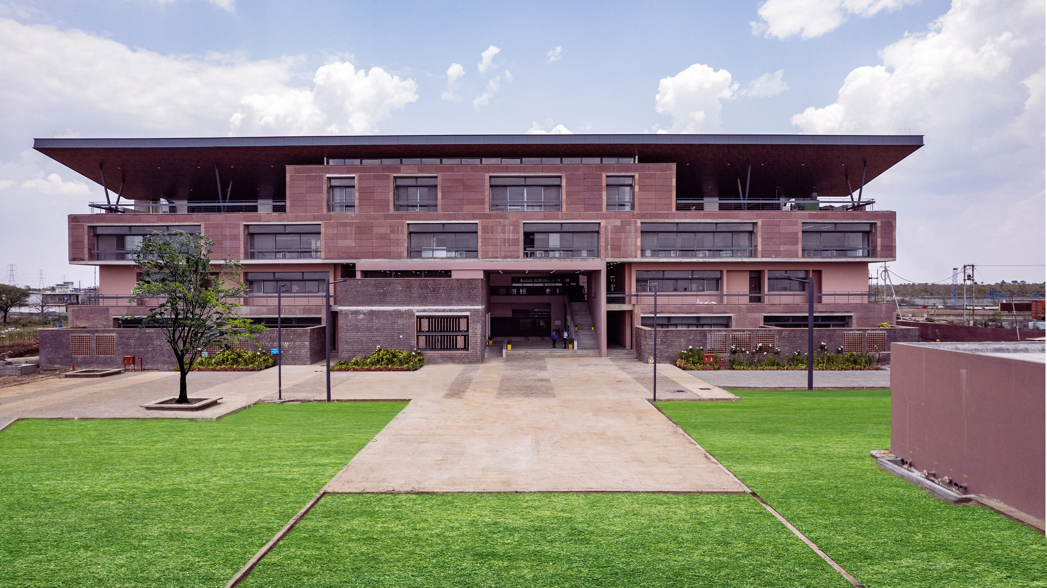
Azim Premji University, Bhopal

Slide 8

Azim Premji Foundation Logo

Slide 9

Azim Premji University Logo

Slide 10
For Media Queries, Contact:
Vipin Nair: Vipin.Nair@azimpremjifoundation.org

